Slide 1

COLIBRI
Display speed sensor screens & Logic
27/3/2014

Slide 2
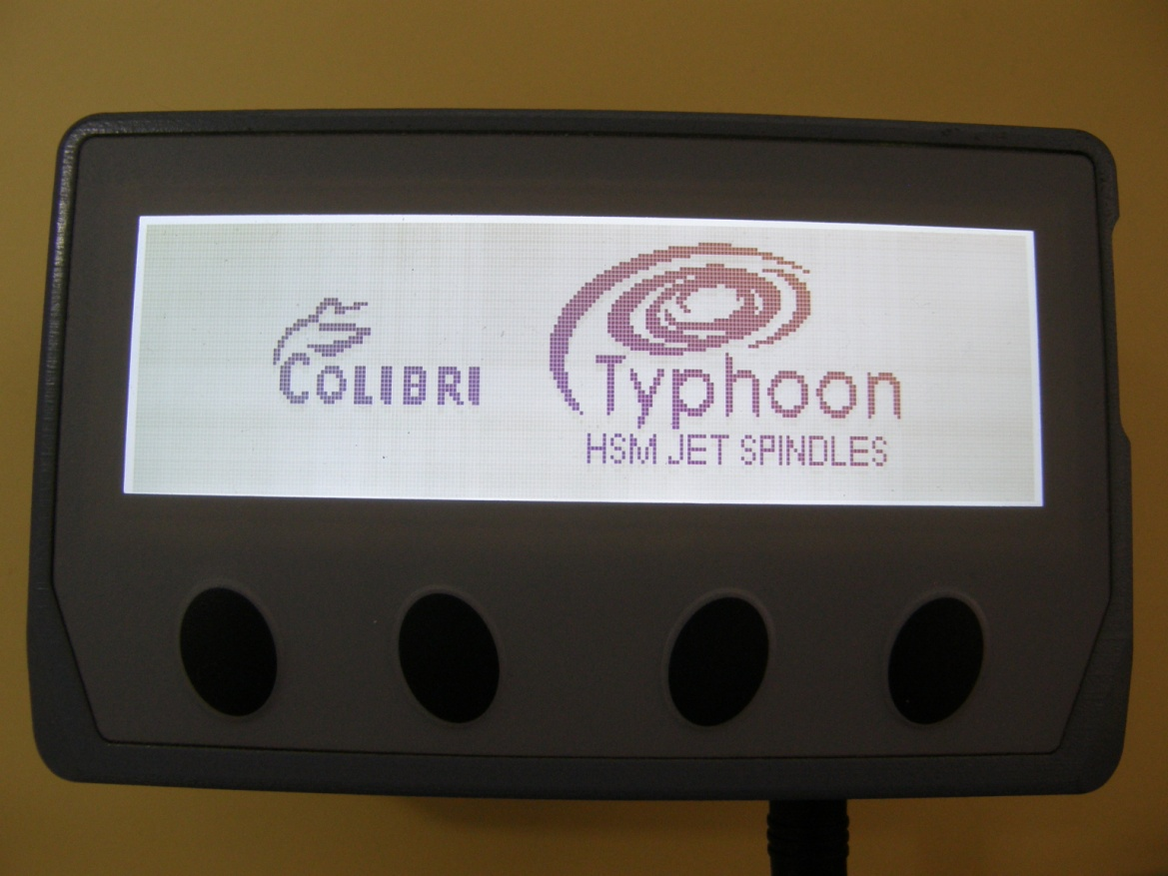
Function Buttons & Connections
X1
X2
X3
X4
POWER
F1
F2
F3
F4

Slide 3
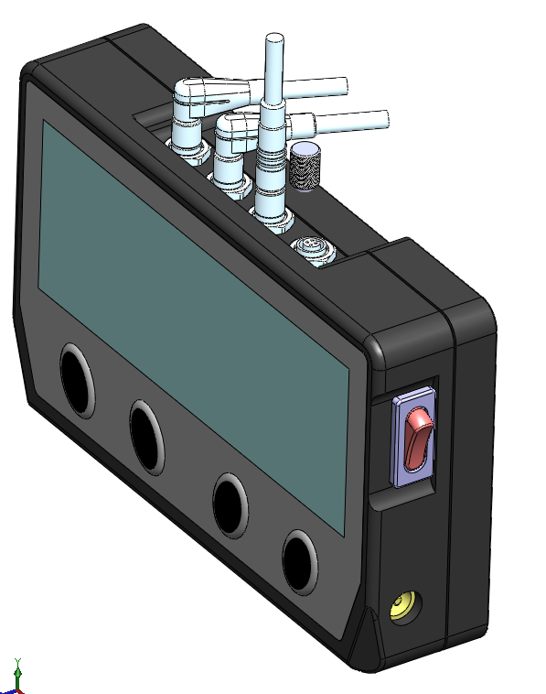
Function Buttons & Connections
X1
X2
X3
X4
F1
POWER
F2
F3
F4

Slide 4
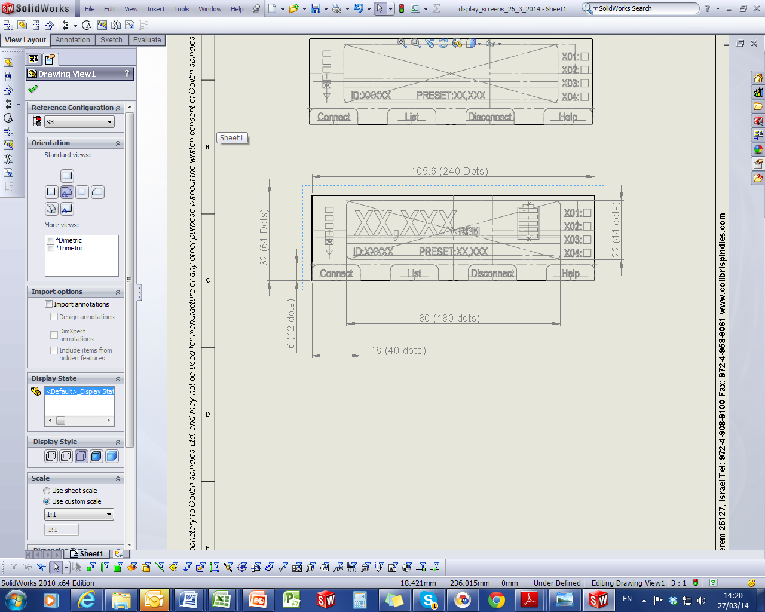
Screen Basic Structure “Operation Mode”
Signal readout
Rpm readout, dark large text
battery
Framed -Transmitter (tag) data
i/o indicators
Error indicator
(not shown)
Small text white on dark round free corners if possible

Slide 5


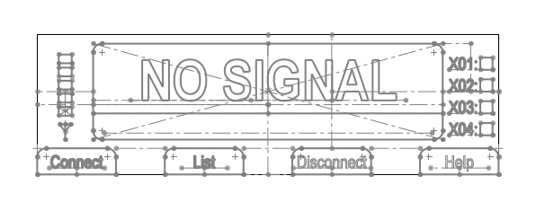
S1 & S2 (No Signal)
S5
LOGO screen
backlights ON
Optional to be replaced in “settings
S10
“no signal” dark text
No signal screen
backlights ON
“no signal” dark text
Dark zone
Dark Buttons bright text

Slide 6
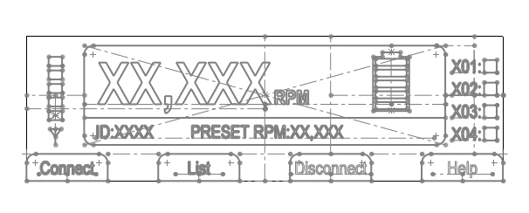
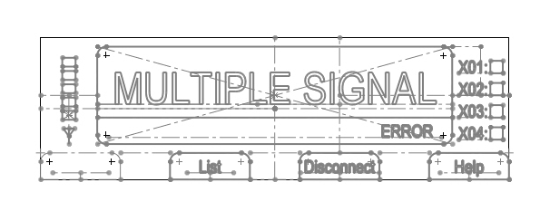
S3 (operation) & S4 (Multiple signal) Error
S15
Operation mode
backlights ON
dark text
S20
Multiple signal ERROR screen
Backlights
flashing
“Error” blinking

Slide 7
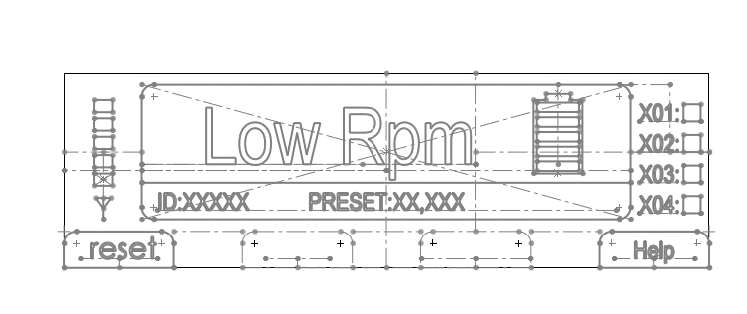
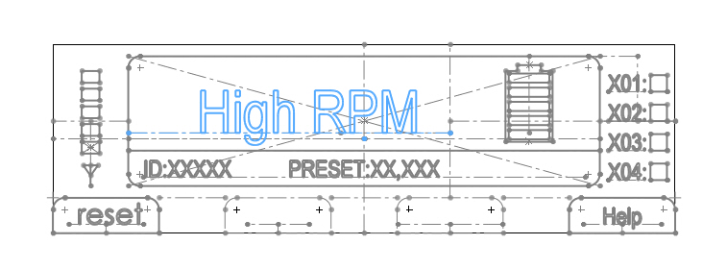
S3 (operation) & S4 (Multiple signal) Error
S25
Low RPM
backlights blinking
S30
High rpm
backlights blinking

Slide 8
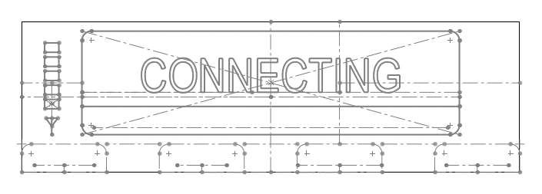
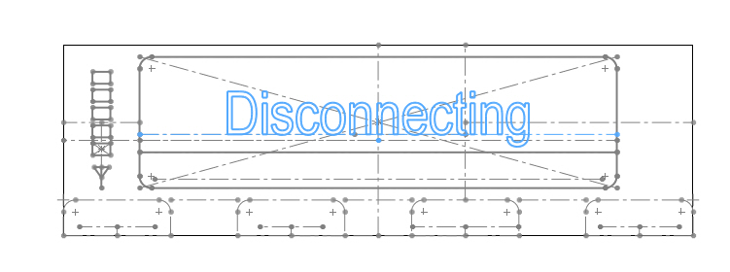
S9 (connected) & S10 (Multiple signal) Error
S35
connecting
backlights
blinking
S40
disconnecting
Backlights
blinking

Slide 9
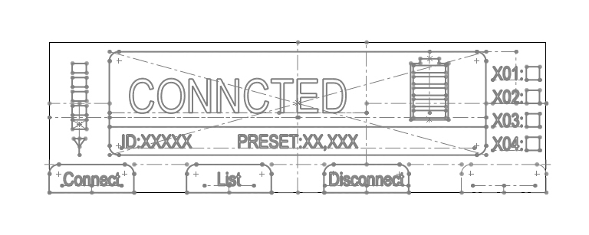
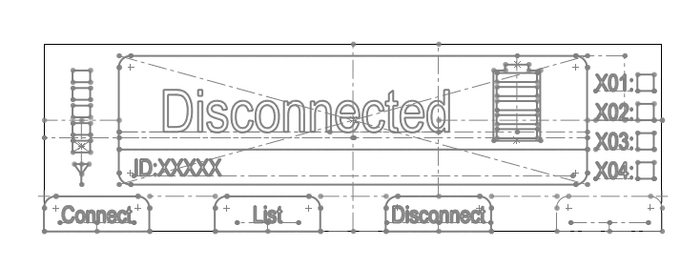
S9 (connected) & S10 (Multiple signal) Error
S45
connected
backlights ON
S50
disconnected
Backlights
on

Slide 10
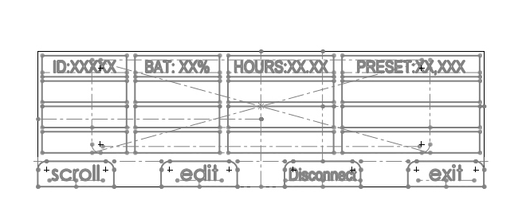
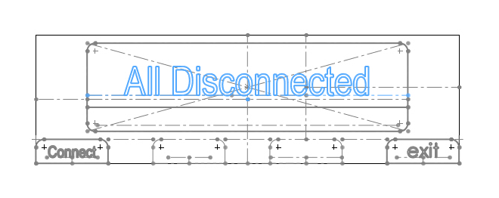
S9 (connected) & S10 (Multiple signal) Error
S55
List
S56
List collusions
backlights ON
S60
All disconnected
Backlights
on

Slide 11
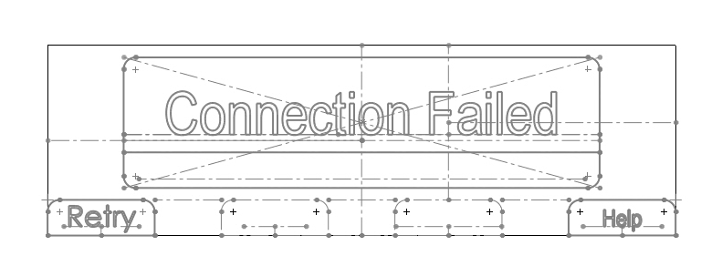
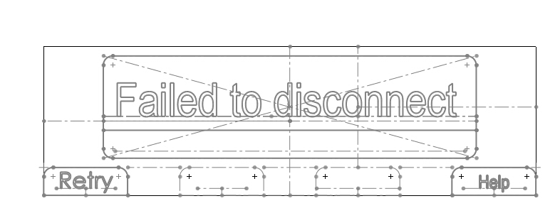
S9 (connected) & S10 (Multiple signal) Error
S65
Failed to connect
backlights blinking
S70
Failed to disconnect
Backlights
blinking

Slide 12
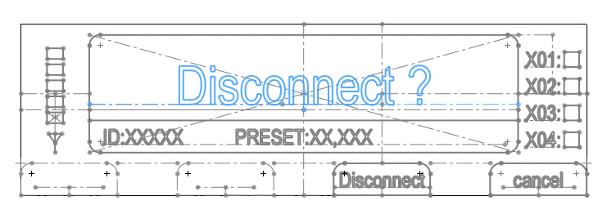
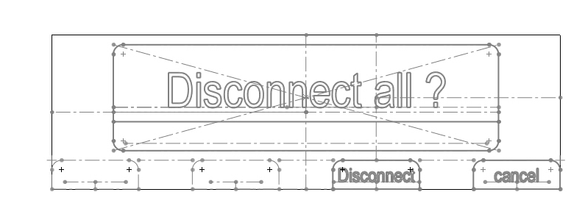
S9 (connected) & S10 (Multiple signal) Error
S75
Disconnect id ?
backlights ON
S80
Disconnect all ?
Backlights
on

Slide 13
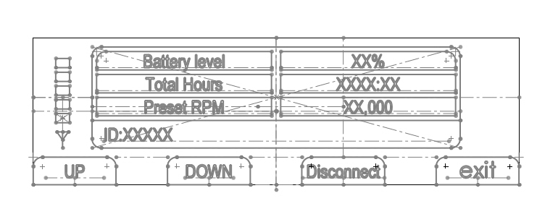
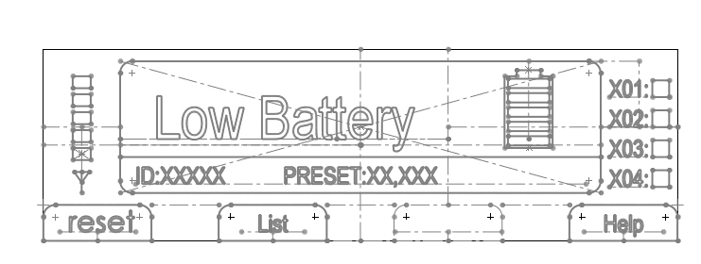
S9 (connected) & S10 (Multiple signal) Error
S85
Device data?
backlights ON
S90
Low bat
Backlights
blinking

Slide 14
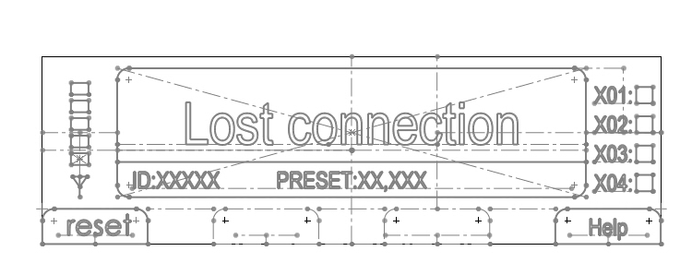
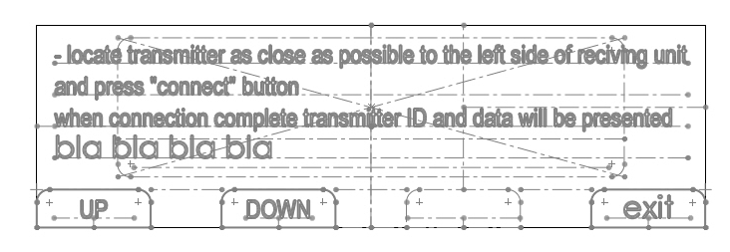
S9 (connected) & S10 (Multiple signal) Error
S95
Lost connection
backlights blinking
S100
No signal help
Backlights
on

Slide 15
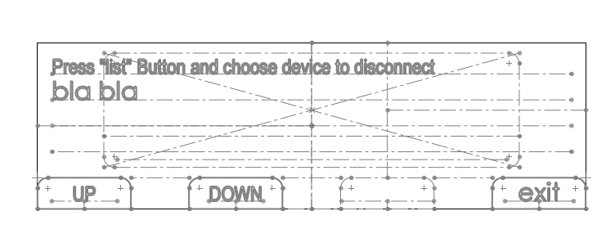
S9 (connected) & S10 (Multiple signal) Error
S105
Multiple signal help
backlights ON
S110
Lost signal help
Backlights
on

Slide 16
S9 (connected) & S10 (Multiple signal) Error
S115
Low rpm help
backlights ON
S120
high rpm help
Backlights
on

Slide 17
S9 (connected) & S10 (Multiple signal) Error
S125
Low battery help
backlights ON
S130
Admin mode
Backlights
on

Slide 18
S9 (connected) & S10 (Multiple signal) Error
S135
password
backlights ON
S140
Logo / history / clear history
Backlights
on

Slide 19
S9 (connected) & S10 (Multiple signal) Error
S145
Typhoon / spin jet
backlights ON
S150
Peak RPM / display hours counter / other
Backlights
on

Slide 20
S9 (connected) & S10 (Multiple signal) Error
S155
Clear history
backlights ON
S160
Disconnect all sensors
Backlights
on

